Slide 1


Winchester Elementary School
Annual Title I Parent Meeting
September 3, 2025
3:00pm-5:00pm
DR. JAMES PATTON, Principal
Mrs. LAJUANA COLE, Vice Principal
Ms. Lois crump, plc coach
Mrs. Angela Jones, Instructional facilitator

Slide 2


Mission & VISION
WINCHESTER MISSION:
At Winchester elementary school, every child will have hope and experience success.
WINCHESTER VISION:
Everyday, Winchester elementary will foster the whole child and develop independent, competent learners who are critical thinkers.

Slide 3

State of Winchester
Current enrollment KK-5: 358 (Pre-K-34)
K-57 students
1st-59 students
2nd-54 students
3rd-50 students
4th-61 students
5th-43 students

Slide 4
State of Winchester
Staffing
15 Title 1 Teachers K-5 2 – Pre-k teachers
4 Support Teachers
1 Functional Skills (FS) Teacher & 1 Sped Teacher
8 Ed Assistants/SEAS
1 ESL Teacher & 1 MULTILINGUAL CULTURAL MENTOR
1 General Office Secretary/1 Financial Secretary
1 Attendance Officer
1 School Nurse
1 Instructional Facilitator
1 PLC coach
1 Asst Principal
I Principal

Slide 5
State of Winchester
School/district initiatives
Improving attendance
Literacy and culture & climate
Rti2 (intervention)
3rd grade commitment (3gC)
Before/after school tutoring
During the day tutoring
Rti2-B (behavior intervention)
District & state level assessments (i-Ready, mastery connect, t-cap, etc.)
Working to fully staff the school

Slide 6
State of Winchester
Memphis-Shelby county schools is a level 5 district! the Winchester elementary took a dip and we have decreased from an overall TVAAS level 4 to TVAAS level 2 status.

Slide 7
State of Winchester
Tcap data 24-25 23-24 22-23
ELA 11.7% 15.3% 10.7%
Math 16.5% 9.7% 2.2%
Science 17.5% 21.1% 12.2%
Success rate: 15.1% 16.3% 13.9%

Slide 8
State of Winchester
24-25 23-24 22-23
Chronic Absenteeism 38.3% 45.9% 48.9%
Goal for chronic absenteeism: 33.5% 40.8% 42.6%

Slide 9
TVAAS Trends 2019-25
School Name | Year | School Wide Composite | School Wide Literacy | School Wide Numeracy | School Wide Literacy & Numeracy | School Wide Science
Winchester Elementary | 2019 | 1 | 1 | 2 | 1 | --
Winchester Elementary | 2021 | 1 | 3 | 1 | 1 | --
Winchester Elementary | 2022 | 5 | 5 | 5 | 5 | 5
Winchester Elementary | 2023 | 1 | 2 | 1 | 1 | 3
Winchester Elementary | 2024 | 4 | 5 | 2 | 3 | 5
Winchester Elementary | 2025 | 2 | 1 | 3 | 2 | 4

Slide 10

TVAAS Trends 2019-25
Early Grades Grade 3 School Wide Composite | Early Grades Grade 3 School Wide Literacy | Early Grades Grade 3 School Wide Numeracy | Early Grades Grade 3 School Wide Literacy & Numeracy
1 | 1 | 3 | 1
-- | -- | -- | --
5 | 4 | 5 | 5
1 | 2 | 1 | 1
1 | 2 | 1 | 1
1 | 1 | 1 | 1

Slide 11
TVAAS Trends 2019-25
TCAP (Grades 4-8) School Wide Composite | TCAP (Grades 4-8) School Wide Literacy | TCAP (Grades 4-8) School Wide Numeracy | TCAP (Grades 4-8) School Wide Literacy & Numeracy | TCAP (Grades 4-8) School Wide Science
2 | 3 | 2 | 2 | --
1 | 3 | 1 | 1 | --
5 | 5 | 5 | 5 | 5
1 | 2 | 1 | 1 | 3
5 | 5 | 3 | 5 | 5
4 | 2 | 5 | 4 | 4

Slide 12
State of Winchester
Amo (Annual measurable objectives) 25-26
Ela 22.7%
Math 26.9%
Science 27.8%
We expect all students to grow from their current levels

Slide 13
How to get back to level 4 or 5 status
1.Come to school daily
*on time and stay the entire day*
2. Support your child’s teacher
3. Have correct information on file
4. Be patient and kind to school employees
5. Assist your students with their work
6. Be responsive to your teachers
7. Attend school functions and meetings
8. Ask your students what they learned on a daily basis
9. Speak life and positivity into your children/minimize exposure to negative influences

Slide 14
Notice of Title I School-wide Program Status
WINCHESTER ELEMENTARY is a title 1 school. OUR school qualifies to receive federal funds under the “every student succeeds act” (ESSA), title I, part A, for the 2025- 2026 school year.
Our school is eligible for the following:
School-wide Title I Program: schools may consolidate and use funds under TITLE I, together with other federal, state, and local funds, when more than 40% of the student body qualifies for free or reduced lunch.

Slide 15

Parents’ Right To Know
All parents have the right to request the following:
A teacher’s professional qualifications, licensure, grade(s)/certification, waivers
A teacher’s bachelor’s and/or graduate degree, fields of endorsement, previous teaching experience
A paraprofessional’s qualifications
An assurance that their child’s name, address, and telephone listing not be released to military recruiters

Slide 16
Parent’s Right To Know Continued…
Their child’s level of achievement on each of the Tennessee academic assessments
Their option to request a transfer to another school within the district if their child is the victim of a violent crime at school
Their right to timely notification that their child has been assigned or has been taught for four or more consecutive weeks by a teacher who does not meet the required licensing and endorsement of the subject being taught.

Slide 17
Teacher Qualifications
IT IS OUR GOAL TO ENSURE THAT ALL teachers at WINCHESTER ELEMENTERY school are certified teachers and highly knowledgeable of their content area.
If your child is taught for 20 days or more by a non-certified/qualified teacher, you will receive the teacher’s status in writing.

Slide 18
Student Code of Conduct
Speaks to the shared responsibility of children’s conduct
Speaks to self discipline being the long-term goal for all students in MSCS
Gives notice of infractions as well as strategies and/or disciplinary measures for levels of offenses. The district policy can be found on the MSCS website.

Slide 19

Academic Progress

Slide 20

Reporting Pupil Progress
WINCHESTER Elementary uses several avenues to report student progress:
Teachers regularly contact parents via phone, email, ClassDojo, and text to address concerns
Mid Semeseter &
Nine-week progress reports
Report cards every Nine weeks
Access to PowerSchool gradebooks
Parents can monitor student grades and attendance by logging into to their PowerSchool account.

Slide 21
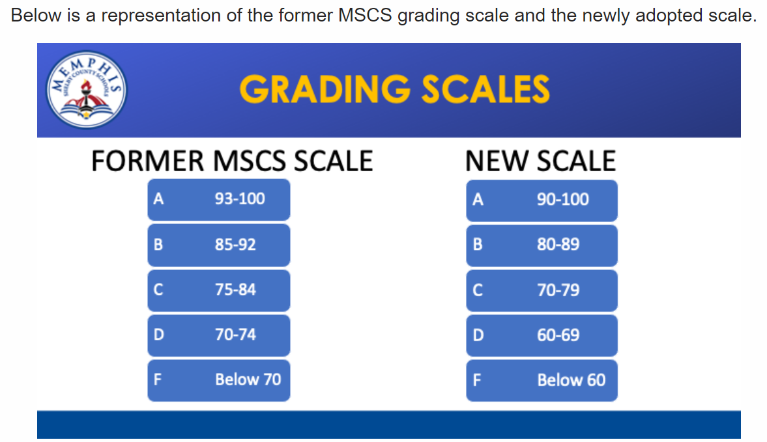
new mscs grading scale

Slide 22
Policies for Parental Involvement

Slide 23

Parental Involvement OPPORTUNITIES
WINCHESTER ELEMENTARY school will have annually scheduled parent meetings.
Meetings provide information that will help parents support their students academically.

Slide 24
Family Engagement Plan
Shelby County Schools’ Family Engagement Policy #4.502
speaks to the following goals:
To provide meaningful two-way communications
To provide meaningful and varied participation by
Families to support student achievement
To eliminate or reduce barriers to greater family
Participation
To provide training opportunities and informational
Seminars for families (letters sent home and via the school’s website

Slide 25
Parent School - Compact
The compact has been jointly developed and agreed upon by parents, students, and the WINCHESTER Elementary School staff.
THE COMPACT CAN BE FOUND ON OUR SCHOOL WEBSITE

Slide 26

What is the School Improvement Plan?
It is a plan that documents:
Academic gains
Academic challenges
Academic Goals
Plan of action

Slide 27
School Improvement Plan
The school improvement plan is updated yearly by the WINCHESTER ELEMENTARY’S leadership Team, teachers, parents, and students.
If you are interested in being a member of the school improvement committee, email CRUMPLA@scsk12.org

Slide 28
THANK YOU FOR WORKING WITH OUR SCHOOL!
Thank you for entrusting our staff with your children. Your support is NEEDED AND APPRECIATED, and we look forward to working with you for the 2024-2025 school year!
"We are one, our cause is one, and we must help each other, if we are to succeed." ~ Frederick Douglass

